Slide 1
Don't Write Secure Code! (Build secure systems instead)
Seth Petry-Johnson @spetryjohnson

Slide 2
I hate writing secure code

Slide 3
I hate writing secure code I hate writing secure features

Slide 4
I hate writing secure code I hate writing secure features I hate implementing cross-cutting security concerns by repeating the same patterns over and over again in my feature-level code

Slide 5
What's on the agenda?
Define "cross cutting" security concerns

Slide 6
What's on the agenda?
Define "cross cutting" security concerns
"Secure by default" examples

Slide 7
What's on the agenda?
Define "cross cutting" security concerns
"Secure by default" examples
Declarative vs Imperative security

Slide 8
What's on the agenda?
Define "cross cutting" security concerns
"Secure by default" examples
Declarative vs Imperative security
Audit / Testing

Slide 9
"Cross cutting" concern
Any security requirement that
spans multiple features

Slide 10

"Cross cutting" concerns
Security Requirements:
User must be logged in
Users with the "Manage Orders" permission see all Orders
Everyone else sees only their own Orders

Slide 11
"Cross cutting" concerns
Security Requirements:
User must be logged in
Users with the "Manage Orders" permission see all Orders
Everyone else sees only their own Orders

Slide 12
"Cross cutting" concerns

Slide 13
"Cross cutting" concerns

Slide 14
"Cross cutting" concerns

Slide 15
"Cross cutting" concerns

Slide 16
"Cross cutting" concerns

Slide 17
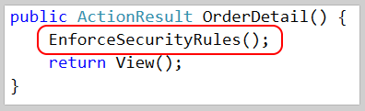
"Cross cutting" concerns

Slide 18
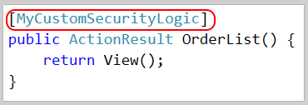
"Cross cutting" concerns

Slide 19

"Cross cutting" concerns

Slide 20
What makes a concern "cross cutting"?
Orthogonal to feature-specific business rules
Applies to multiple features

Slide 21
What belongs in the "framework"?
All "cross-cutting" concerns
Anything that can be made "secure by default"
Anything that needs auditing / global testing

Slide 22
Show me the codez! bit.ly/2i0J91d

Slide 23
SQL Injection Little Bobby Tables, at it again

Slide 24
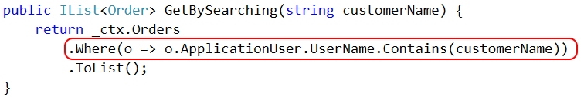

SQL Injection

Slide 25
Cross Site Request Forgery Fun fact*: users never log out. Ever.
* Not actually a fact.

Slide 26
Cross Site Request Forgery (CSRF)

Slide 27
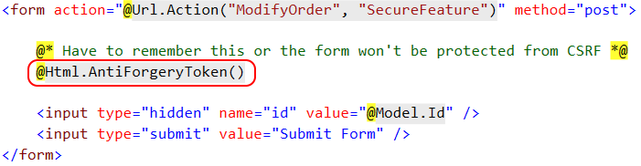
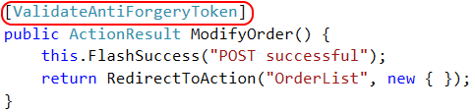
CSRF Defense – feature

Slide 28

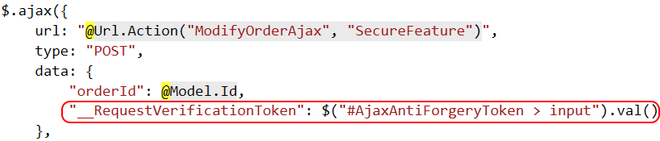
CSRF Defense – feature (ajax)

Slide 29
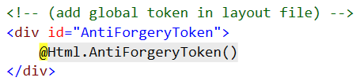
CSRF Defense – cross cutting

Slide 30
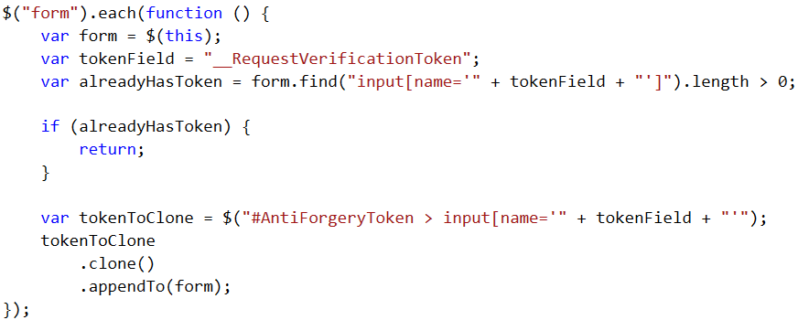
CSRF Defense – cross cutting

Slide 31
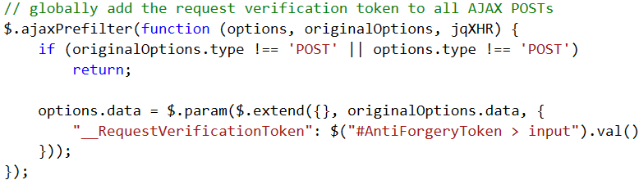
CSRF Defense – cross cutting

Slide 32
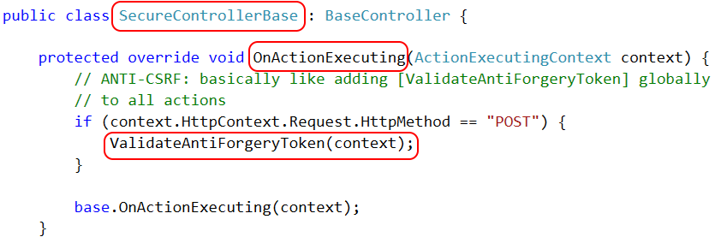
CSRF Defense – cross cutting

Slide 33

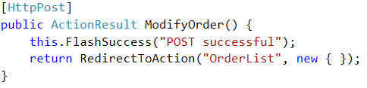
CSRF Defense – cross cutting

Slide 34
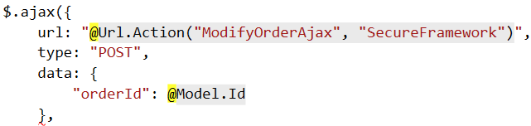
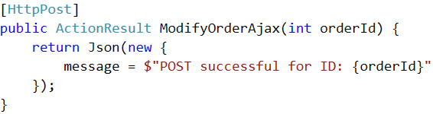
CSRF Defense – cross cutting (ajax)

Slide 35
Authentication Keeping out the unwashed masses

Slide 36
Authentication

Slide 37
Authentication

Slide 38
Access Control Keeping Bob's hands off Alice's data

Slide 39
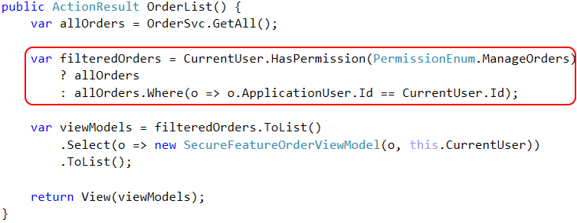
Access Control – feature

Slide 40
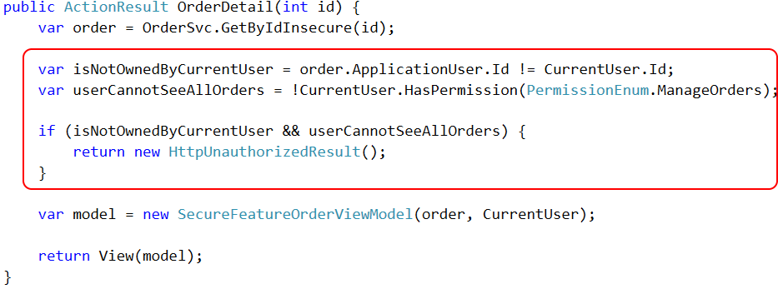
Access Control – feature

Slide 41
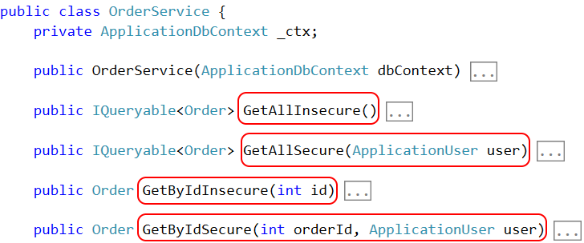
Access Control – framework

Slide 42
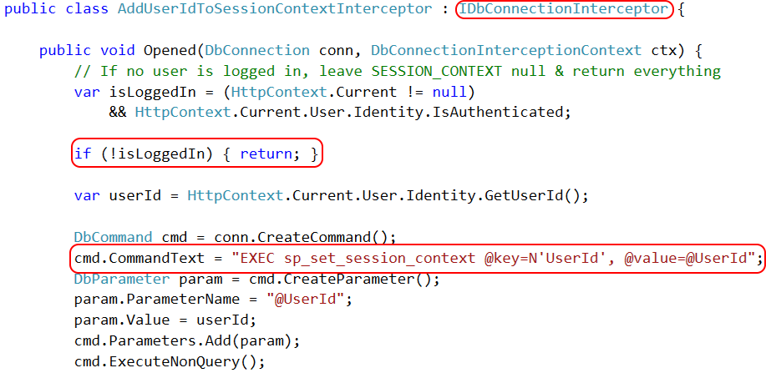
Access Control – Row Level Security

Slide 43
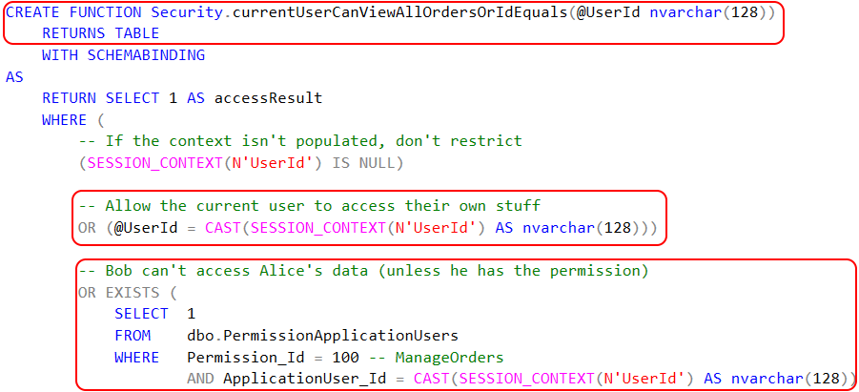
Access Control – Row Level Security

Slide 44

Access Control – Row Level Security

Slide 45
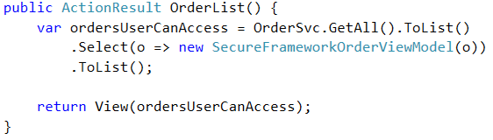
Access Control – framework

Slide 46
Page-level Authorization Security by obscurity is weak sauce

Slide 47
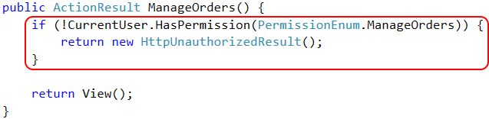
Page Authorization – feature

Slide 48

Page Authorization – cross cutting

Slide 49
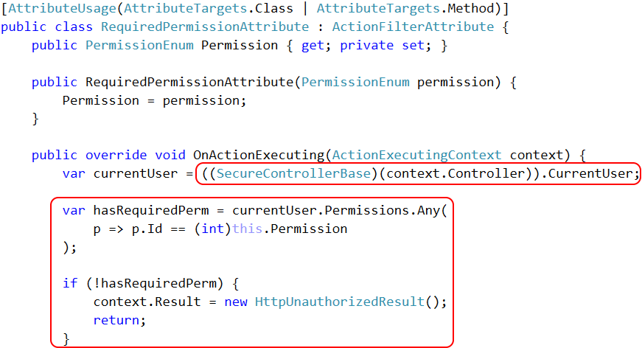

Slide 50
Property-level Authorization Keeping private data private!

Slide 51
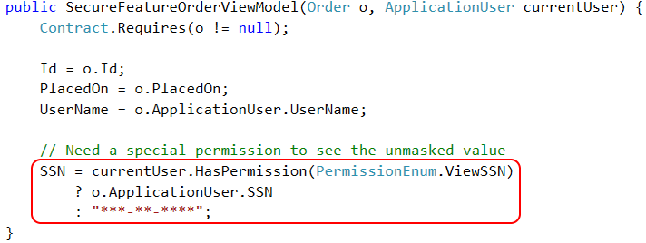
Property Authorization – feature

Slide 52
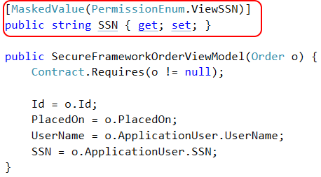
Property Authorization – cross cutting

Slide 53
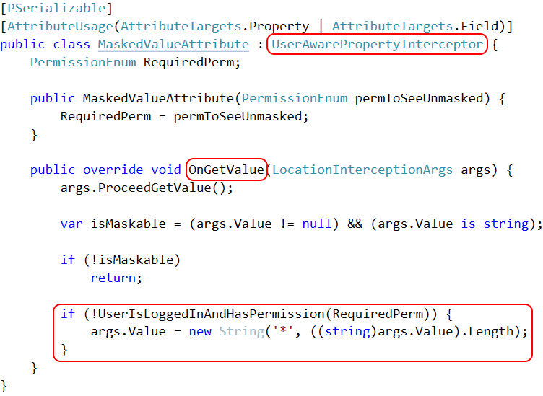

Slide 54
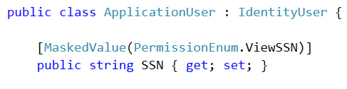
Property Authorization – cross cutting

Slide 55

Property Encryption – cross cutting

Slide 56
Auditing and Testing Try this with your fancy dynamic language!

Slide 57
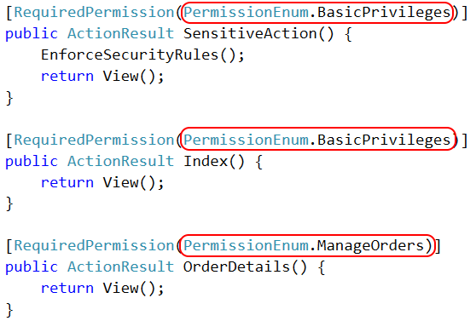
Authorization auditing

Slide 58
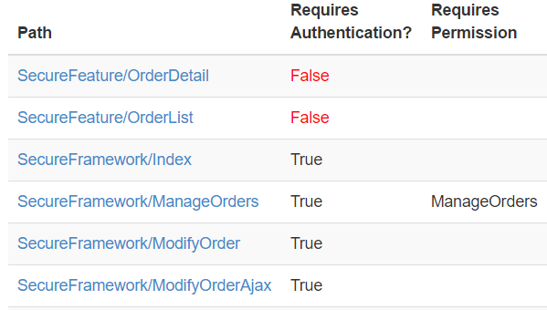
Authorization auditing

Slide 59
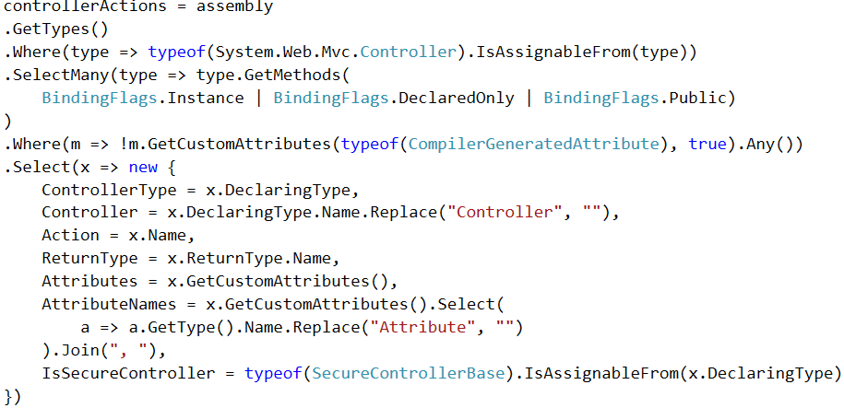
Authorization auditing

Slide 60
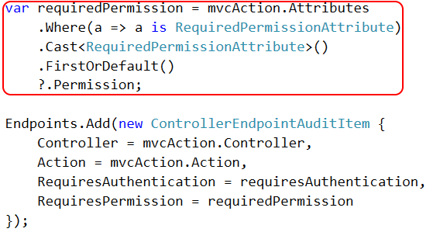
Authorization auditing

Slide 61
Authorization auditing

Slide 62

http://approvaltests.com

Slide 63
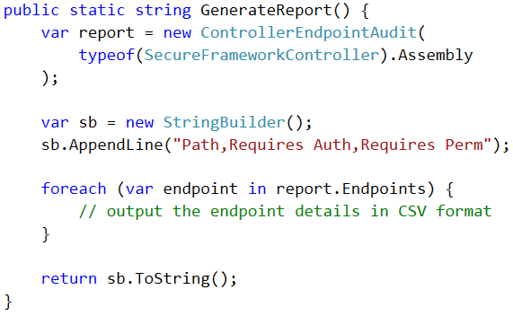
Approval Tests – Step 1

Slide 64
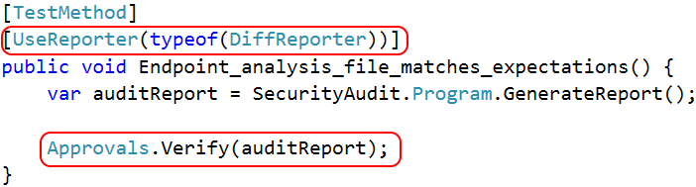
Approval Tests – Step 2

Slide 65
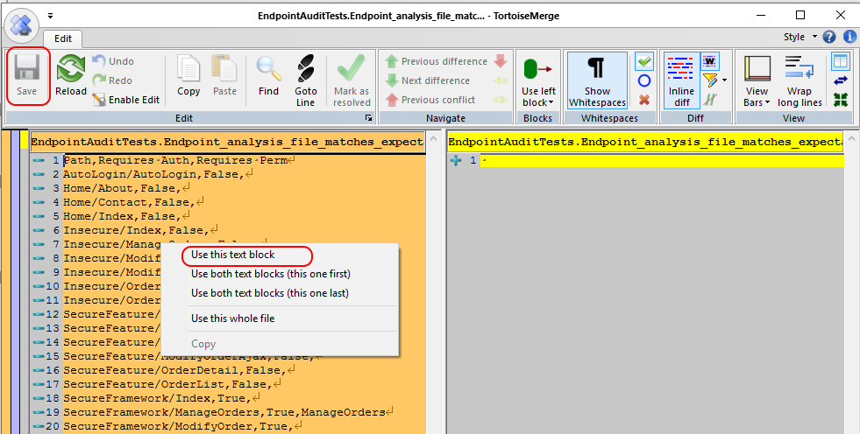

Slide 66
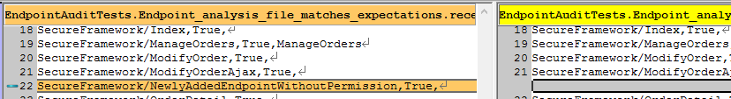

Slide 67
Patented step-by-step slide
Old news
New hotness

Slide 68
Canonical example: SQL Injection

Slide 69
Closing slide
The knowledge gets dropped here
github.com/spetryjohnson | www.petry-johnson.com
@spetryjohnson

